Slide 1
AI Applications
Modern applications of Artificial Intelligence
Hamidreza Hosseinkhani
School of AI - 2018

Slide 2
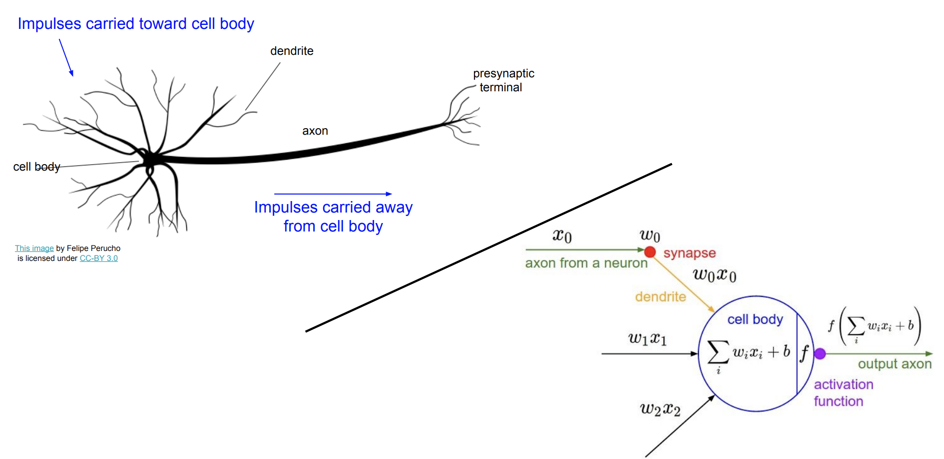
Artificial Neuron

Slide 3
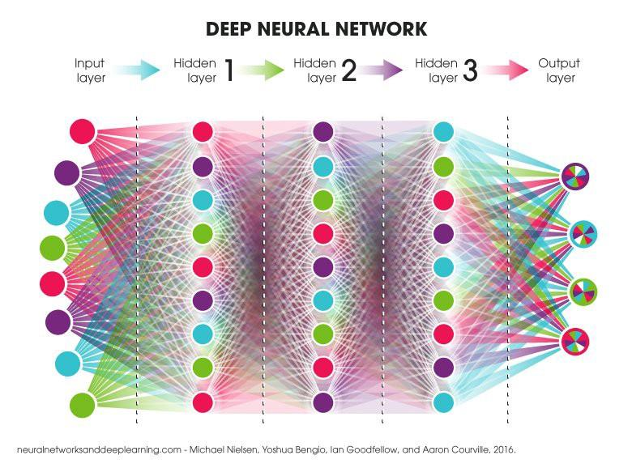
Artificial Neural Network - Deep Learning

Slide 4
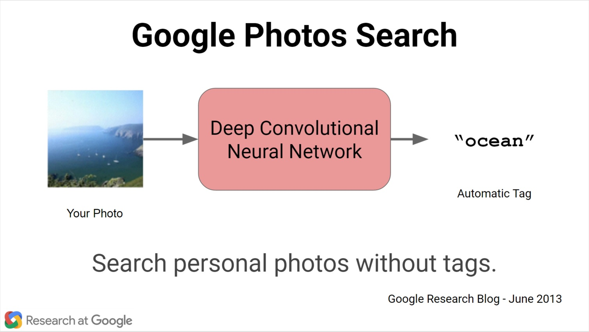
Automatic Image Tagging

Slide 5
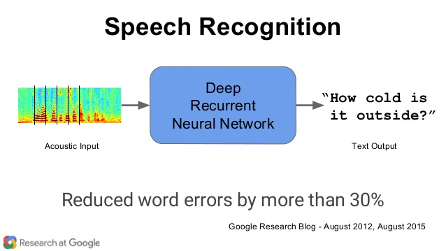
Speech to Text

Slide 6
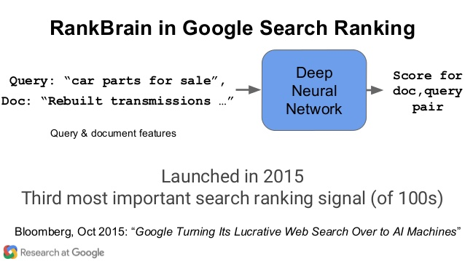
Page Ranking

Slide 7
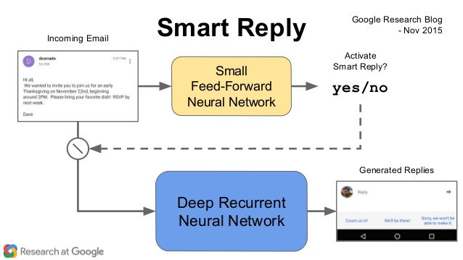
Auto Reply

Slide 8
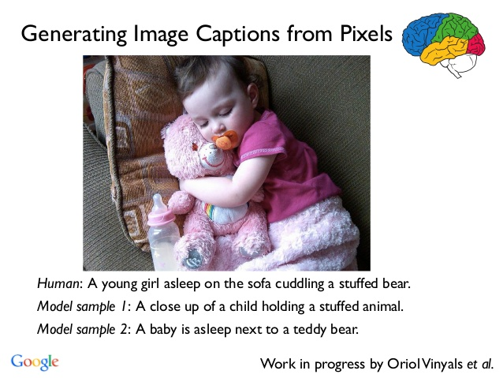
Image Captioning

Slide 9
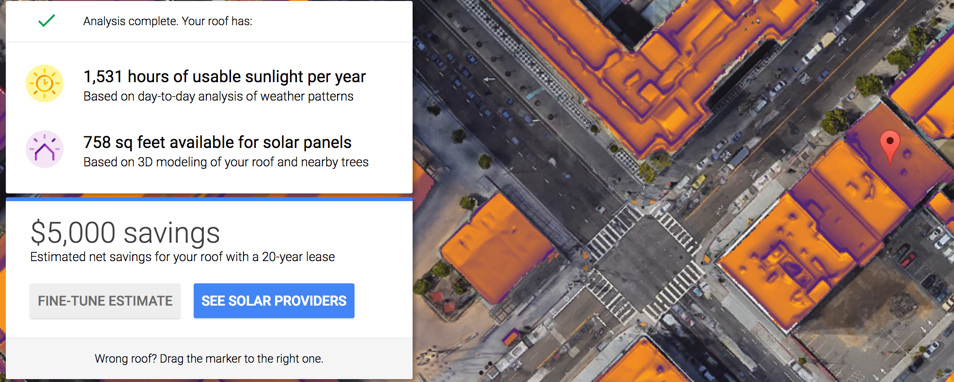
Estimate solar savings potential

Slide 10
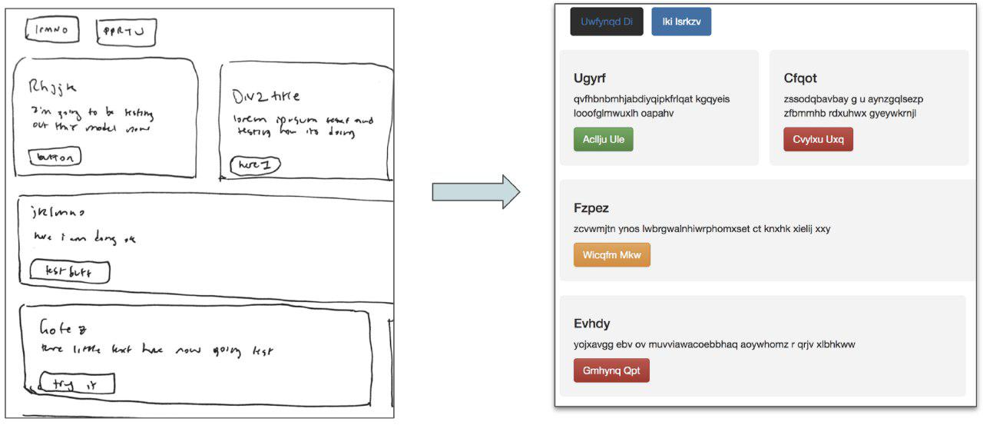
Front-end Development

Slide 11
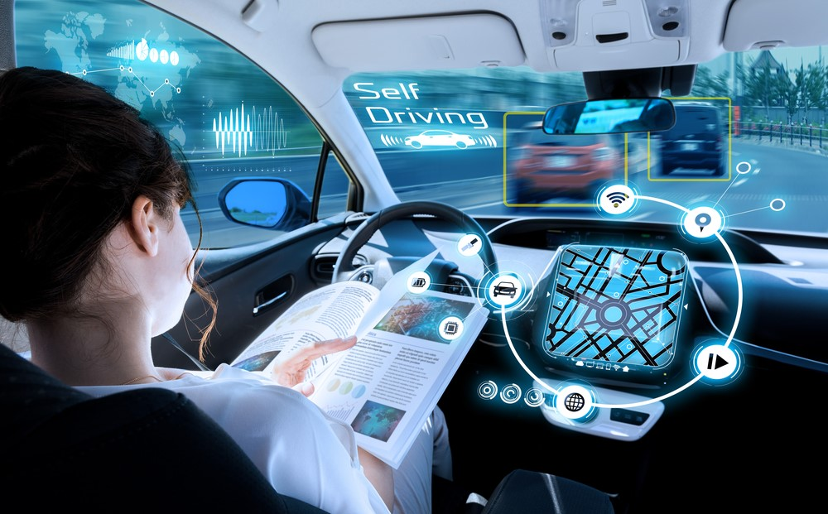
Self-driving Cars

Slide 12
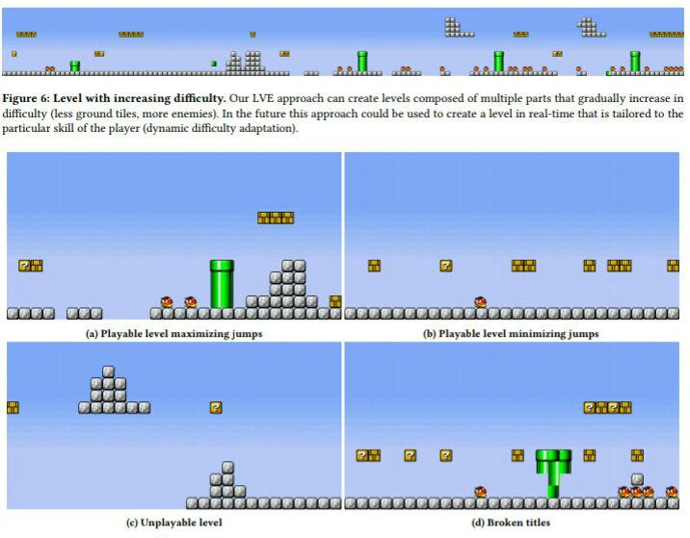
Generate New Game Levels

Slide 13
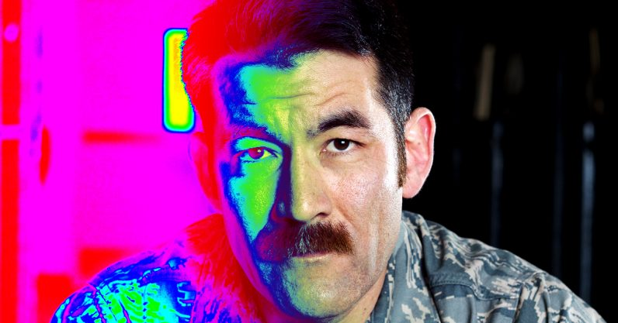
Recognize faces in the dark and through walls

Slide 14
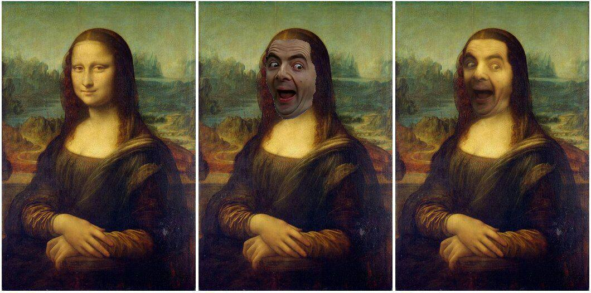
Deep Painterly Harmonization

Slide 15
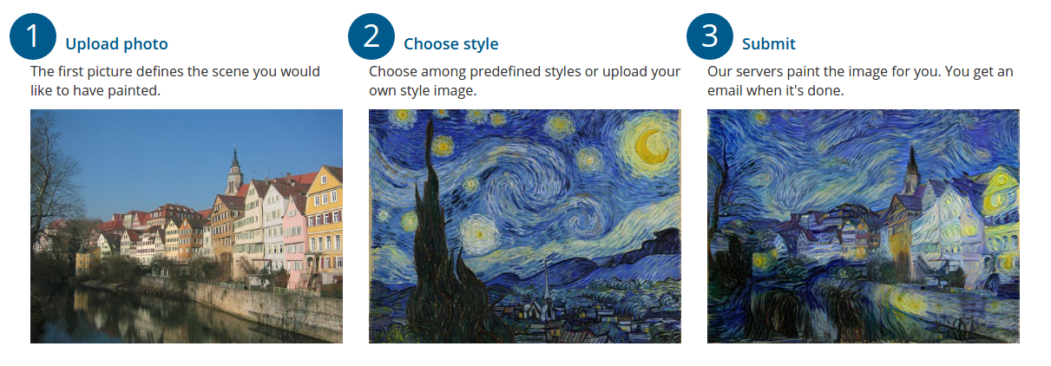
Style Transfer

Slide 16
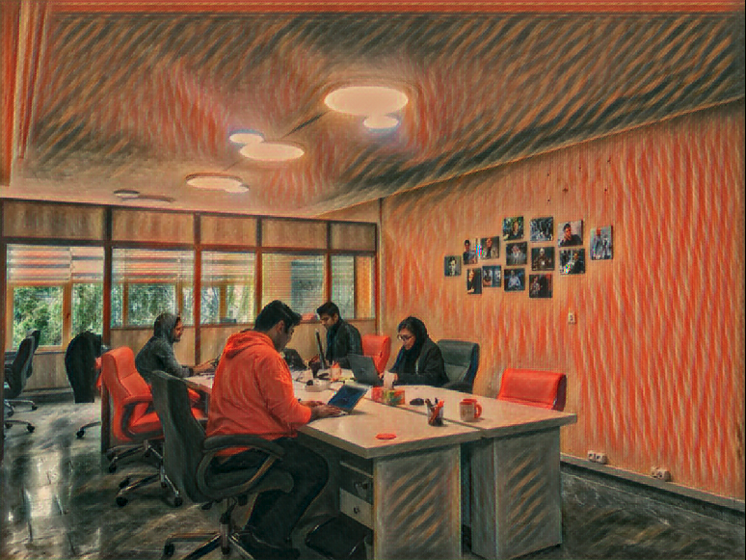
Style Transfer

Slide 17
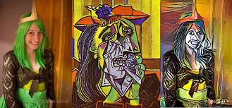
Deep Style

Slide 18
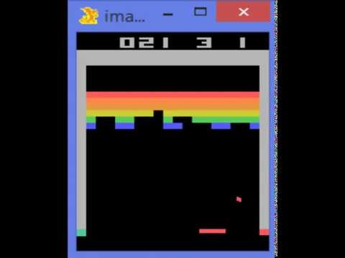
Play ATARI Games

Slide 19
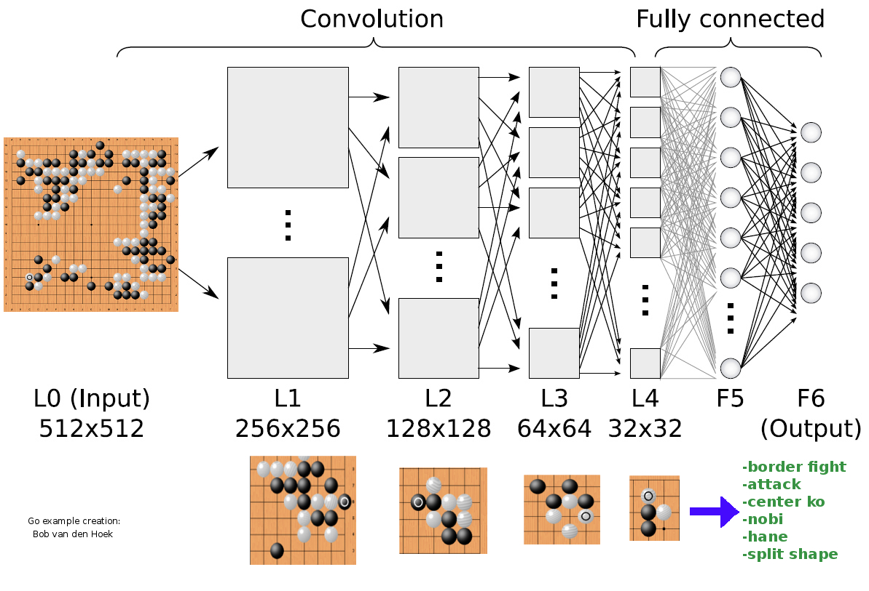
Play Board Games

Slide 20
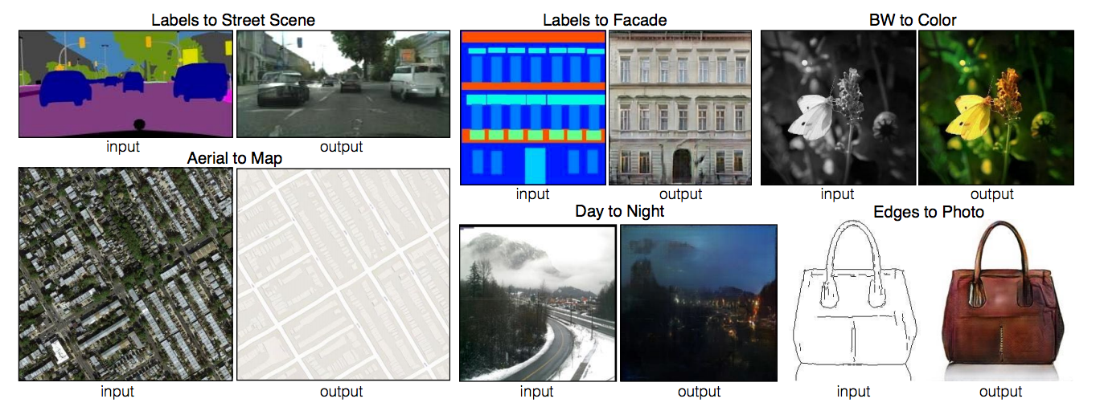
Image Generation

Slide 21
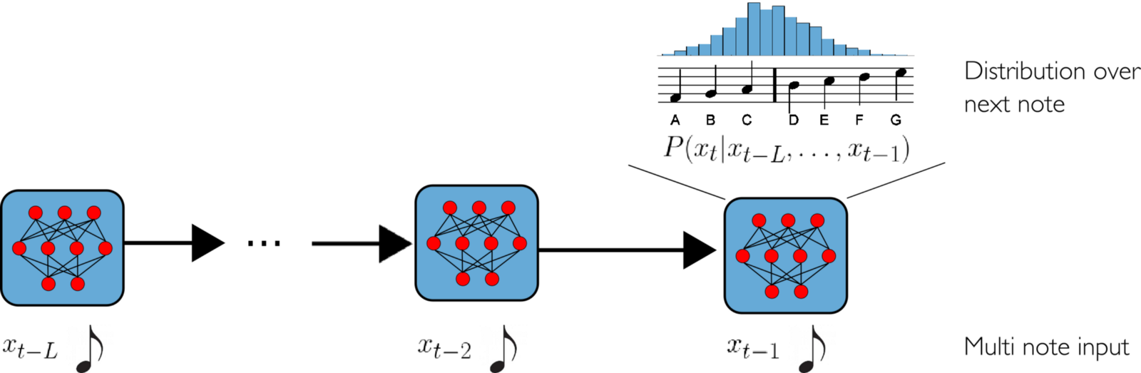
Music Generation

Slide 22
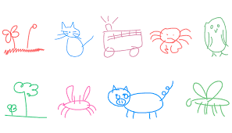
Drawing

Slide 23
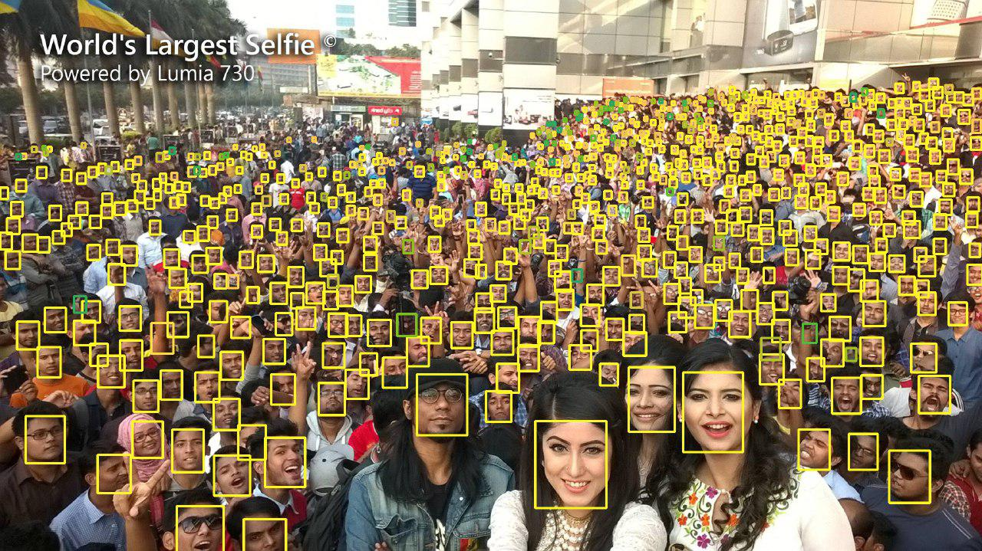
Finding Tiny Faces

Slide 24
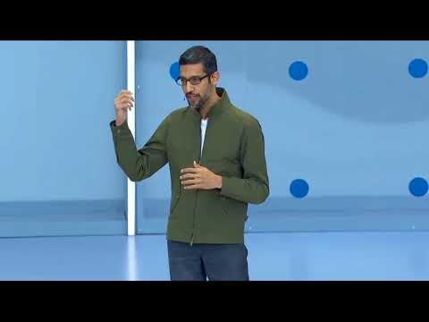
Google Duplex

Slide 25
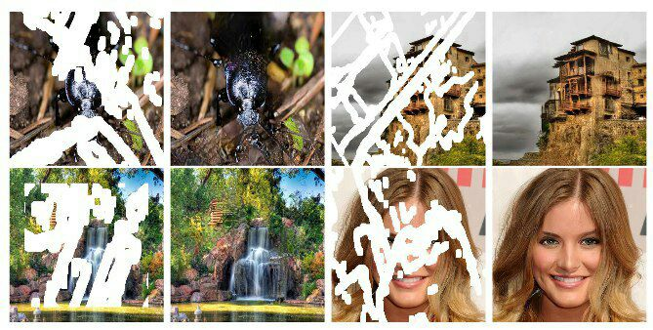
Image Inpainting

Slide 26
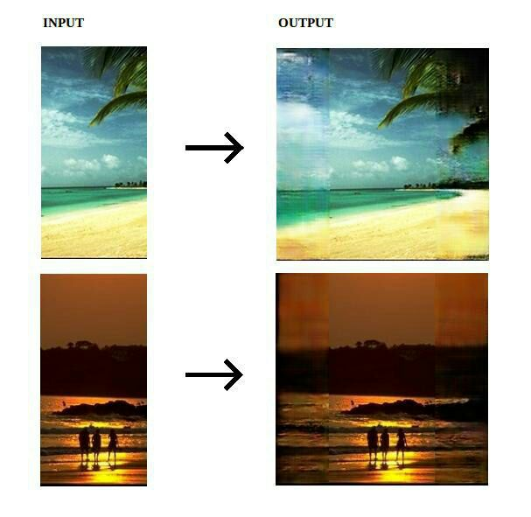
Image Outpainting

Slide 27
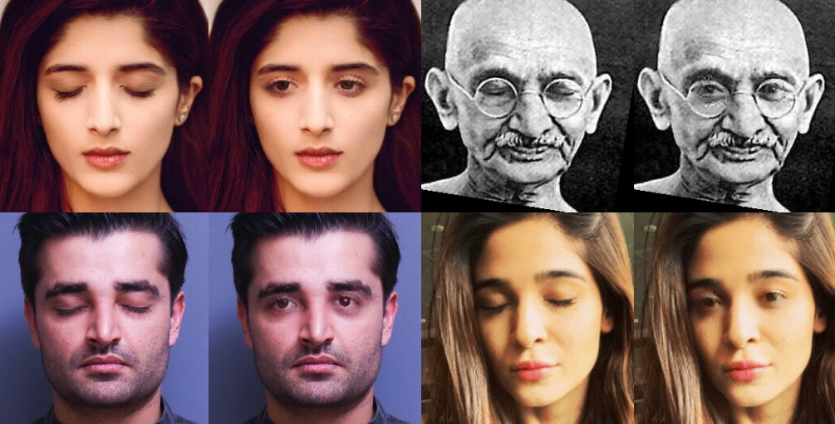
Eye-opener

Slide 28
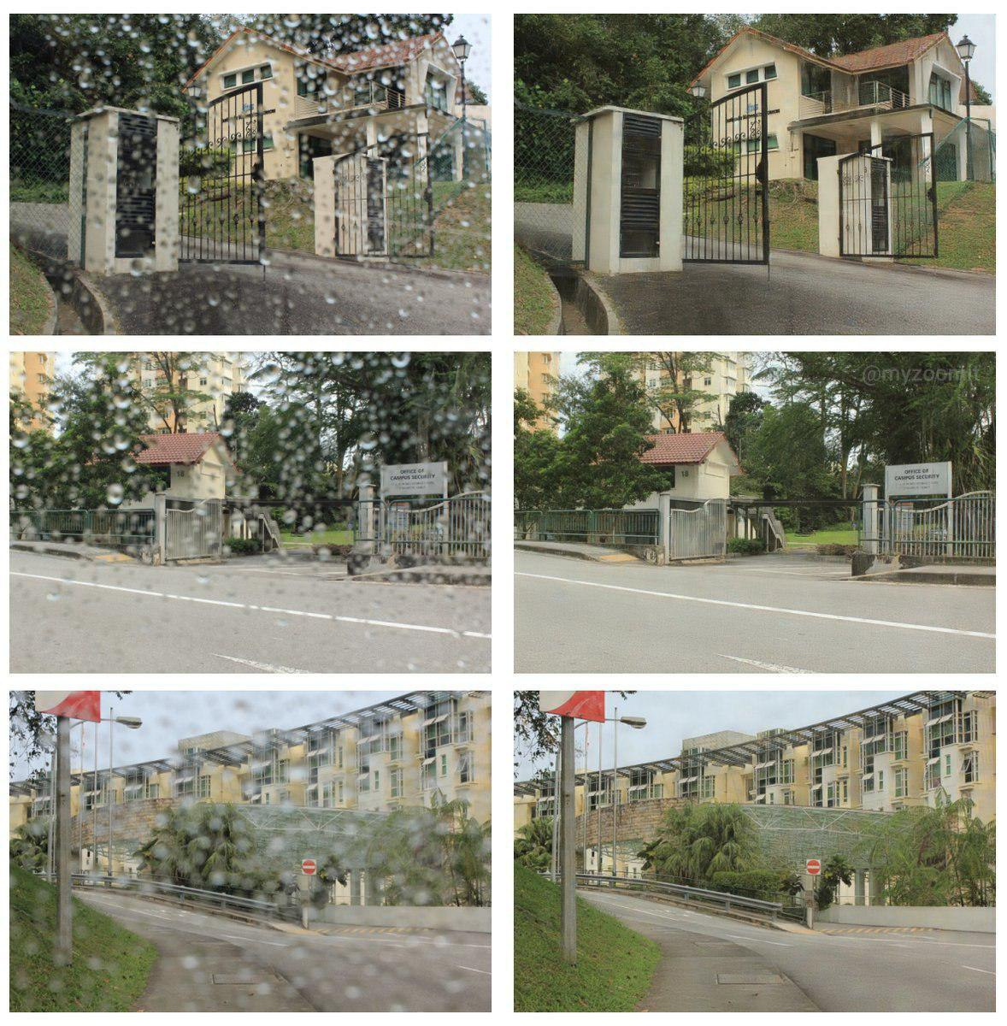
Raindrop Removal from a Single Image

Slide 29
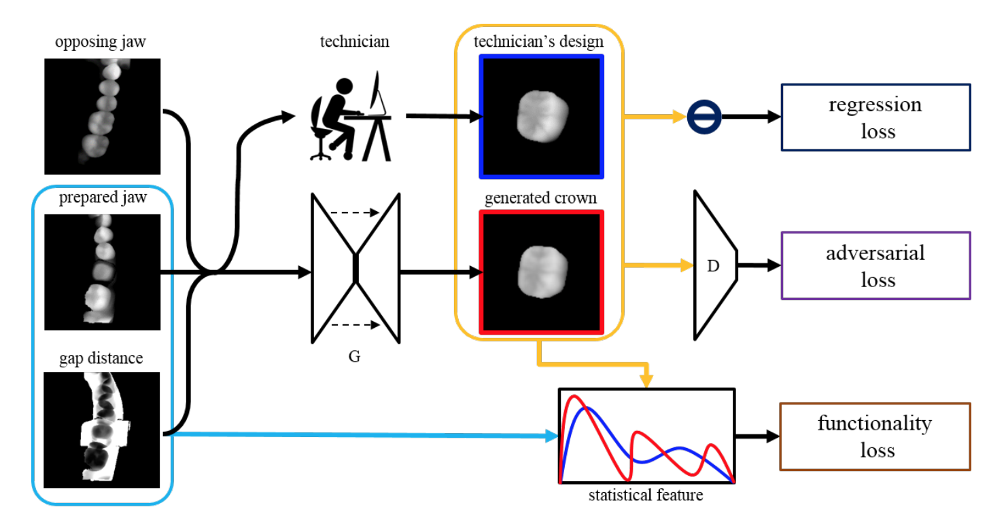
Design Dental Crowns

Slide 30
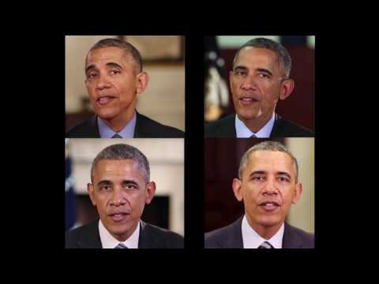
Learning Lip Sync from Audio

Slide 31
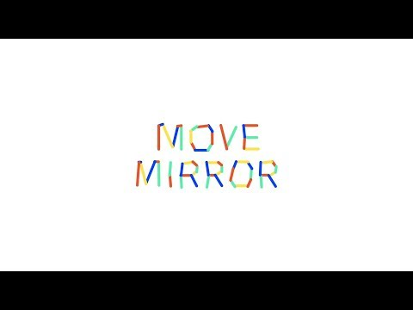
Move Mirror

Slide 32
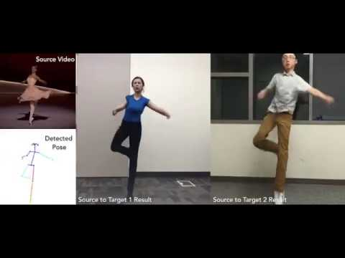
Everybody dance now!

Slide 33
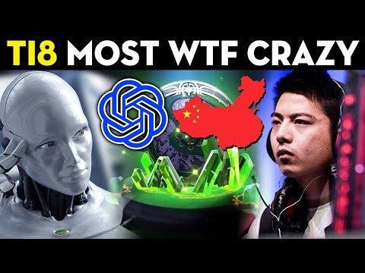
Play Dota 2

Slide 34
Thank You!

